Slide 1


183 DB Weekly Report
Final Presentation Team Parsley
Lin Li, Amir Omidfar, Wilson Chang, Angel Jimenez

Slide 2
Underactuated Robotics
Interest on underactuated Robotics
Make use of system dynamics, more natural, cost and power efficient
Inspiration from Rocket Control, controller for steering
Explore the possibility through a quadcopter
Notes:
Had interest on underactuated Robotics
Inpsiration from Rocket Control, we want to build a controller

Slide 3
Outline
Mathematical Model
Simulation
Motor Exploration
Actual Implementation
Conclusion and Expectation for demo

Slide 4
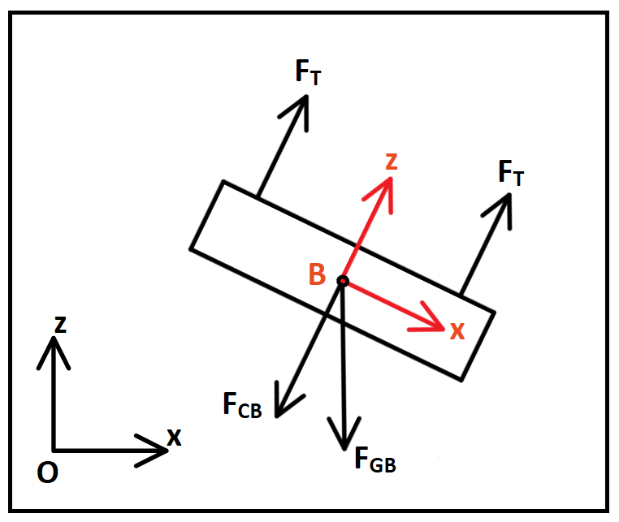
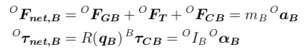
Body Model
Image 1 holder

Slide 5
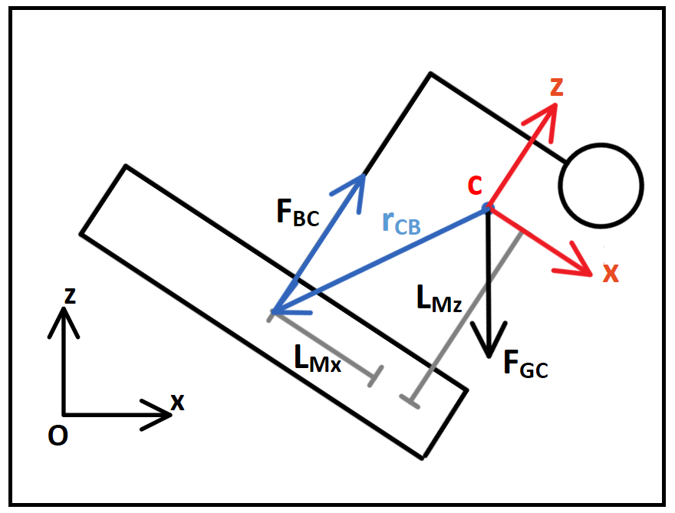
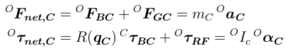
Controller Model
Img 2 holder

Slide 6
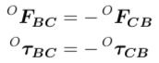
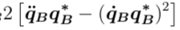
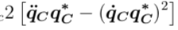
Merging equations
We could never know the reaction force and torque
Angular acceleration
From Newton’s 2nd Law of Motion

Slide 7
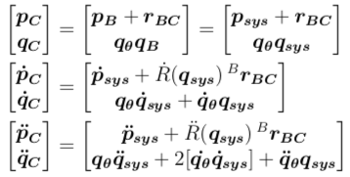
System State
Define state of the system
F

Slide 8

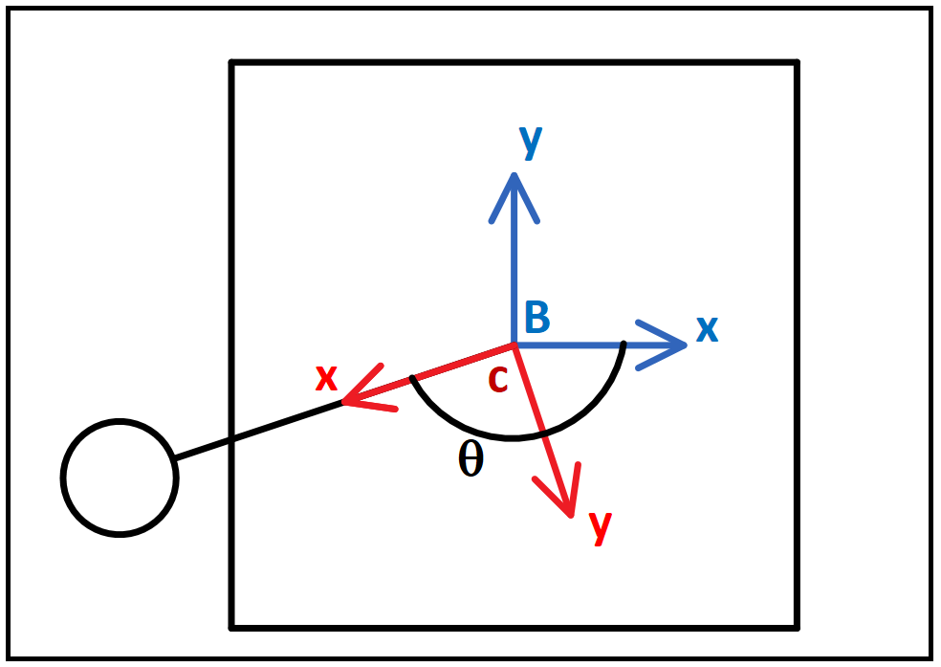
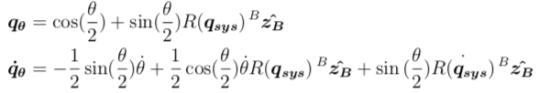
State Variable:
Yaw angle difference
Turn into Quaternion expression

Slide 9
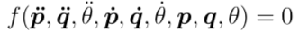
System of equations
8 equations, 8 unknows,
Should be able to

Slide 10
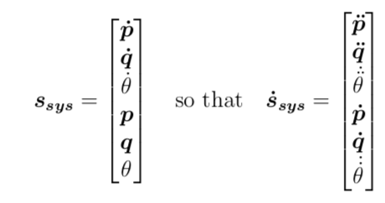
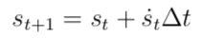
Matlab Implementation
State evolution equation
-
Unfortunately, implementation in Matlab yield no solutions....

Slide 11
Math Modelling: Challenges
Rotation is hard
No close form solution
Rely on numerical method
A lot can go wrong

Slide 12
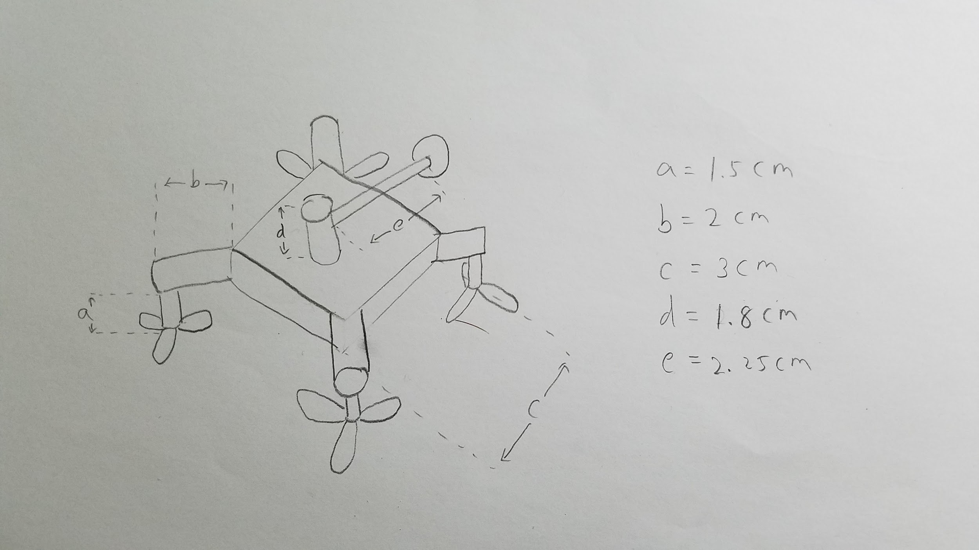

Simulation: Building 3D Geometric Structure
Starting from measuring and sketching
Making a list of geometric components
Main body -- Box shape: 1
Motor -- Cylinder shape: 1
Mass stick -- Cylinder shape: 1
Mass -- Sphere shape: 1
Leg -- Cylinder shape: 4
Propeller holder -- Cylinder shape:4
Propeller : 4

Slide 13

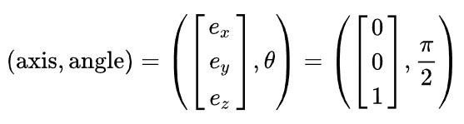
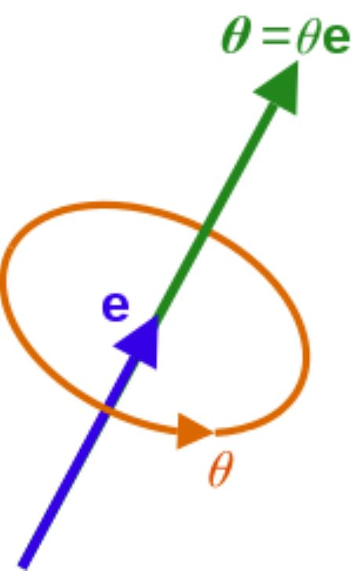
Simulation: Building 3D Geometric Structure
Simulink: 3D world editor
Axis-angle representation( Quaternion )

Slide 14
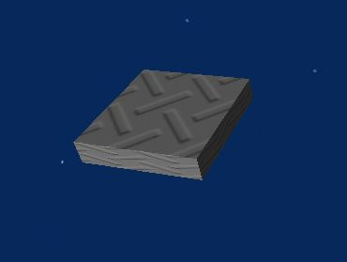
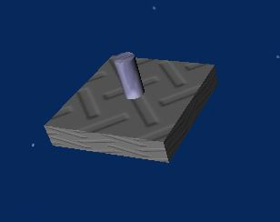
Simulation: Building 3D Geometric Structure
Starting with the main body
Adding the motor

Slide 15
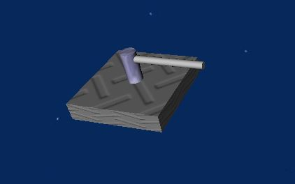
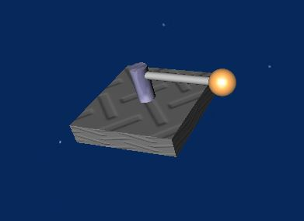
Simulation: Building 3D Geometric Structure
Adding the spinning stick
Adding the mass

Slide 16
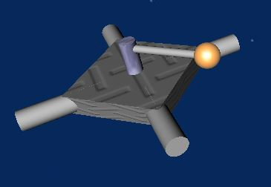
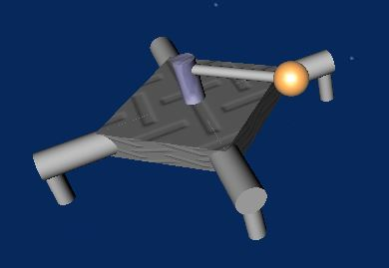
Simulation: Building 3D Geometric Structure
Adding the legs
Adding the propeller holders

Slide 17
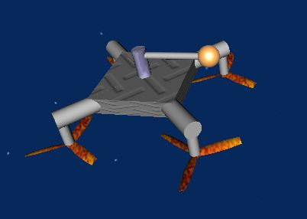
Simulation: Building 3D Geometric Structure
Adding the propellers

Slide 18
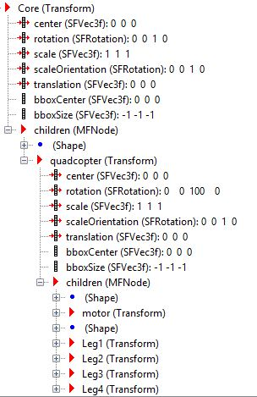
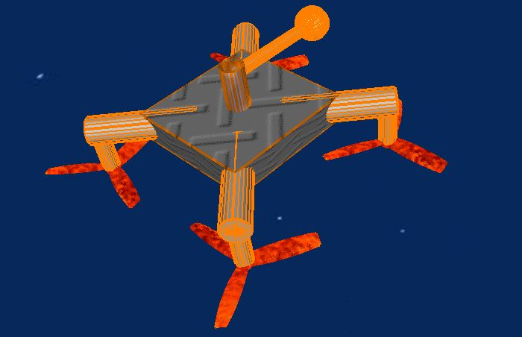
Simulation: Building 3D Geometric Structure

Slide 19
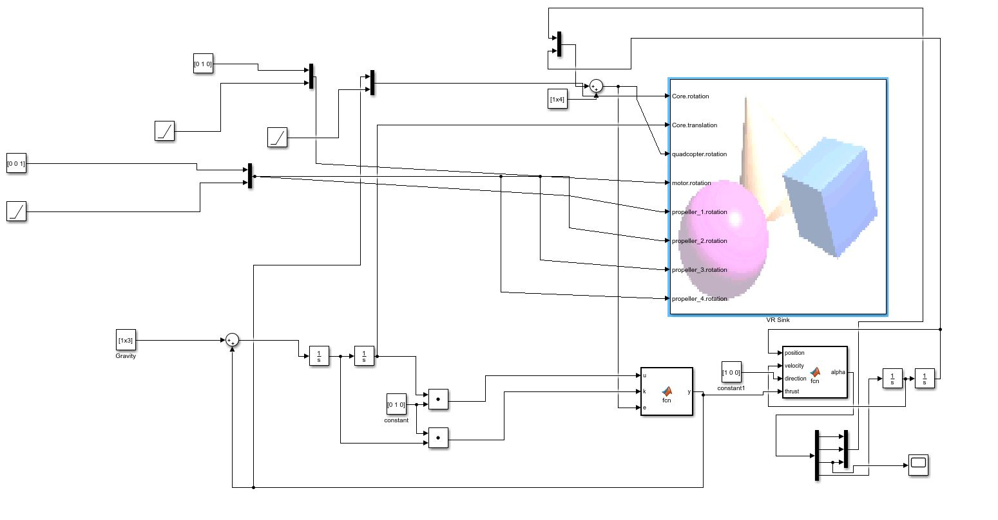
Simulation: Updating State Information
Simulink block diagram

Slide 20
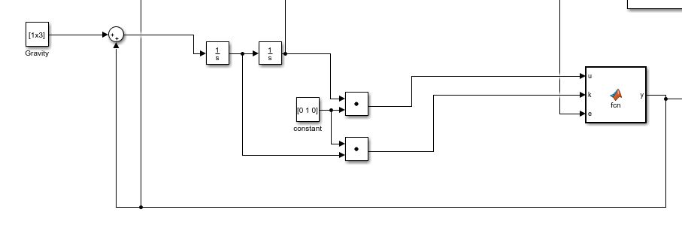
Simulation: Updating State Information
The net force calculating system

Slide 21
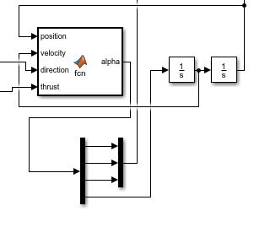
Simulation: Updating State Information
The net torque calculating system

Slide 22
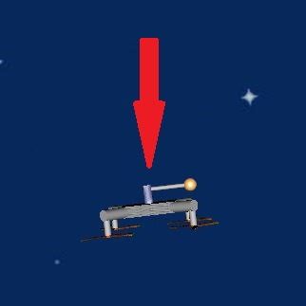
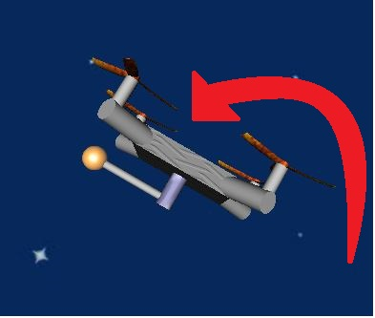
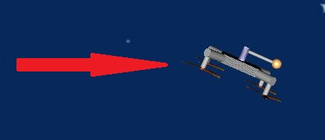
Simulation: Conclusion
Low spinning rate
High load/max load ratio
Optimal parameter setting
Simulation Demo Video: https://www.youtube.com/watch?v=o9f2x5YUPoA

Slide 23
Simulation: Challenges
Getting used to quaternion representation
Making assumptions
Adding more and more math details

Slide 24
Conclusion: Model and Simulation
Hard control problem
Deriving an exact mathematical model may be even harder
Spent 5 weeks on this
Focus started to shift towards the practical implementation

Slide 25
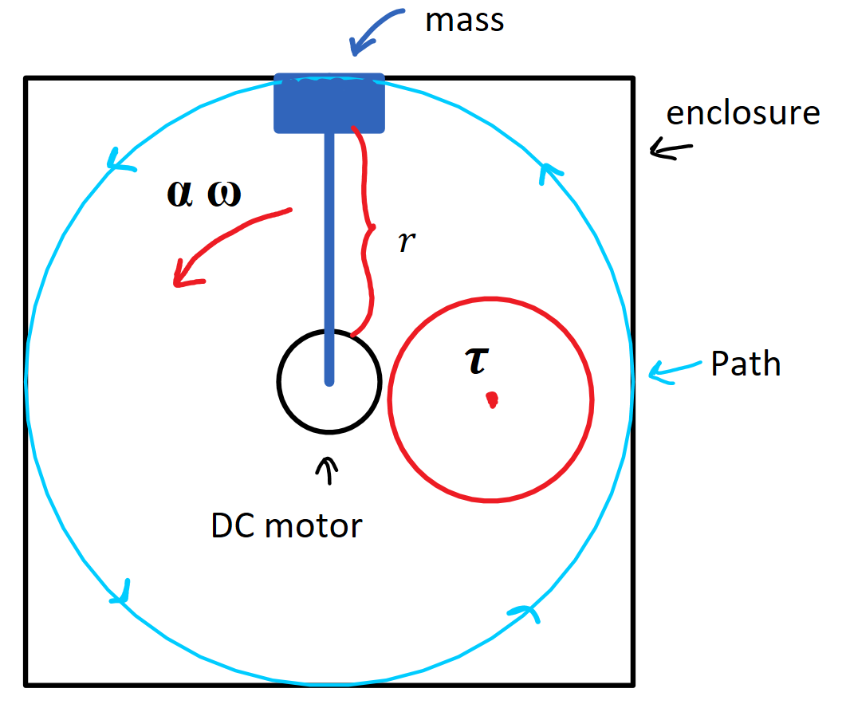
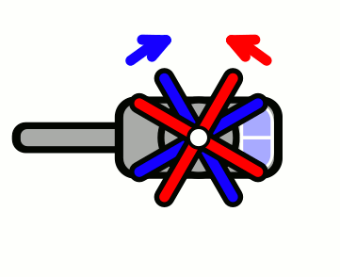
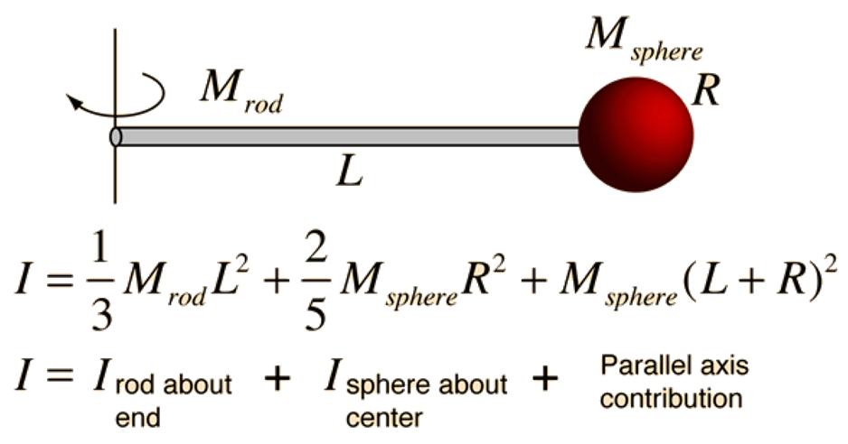
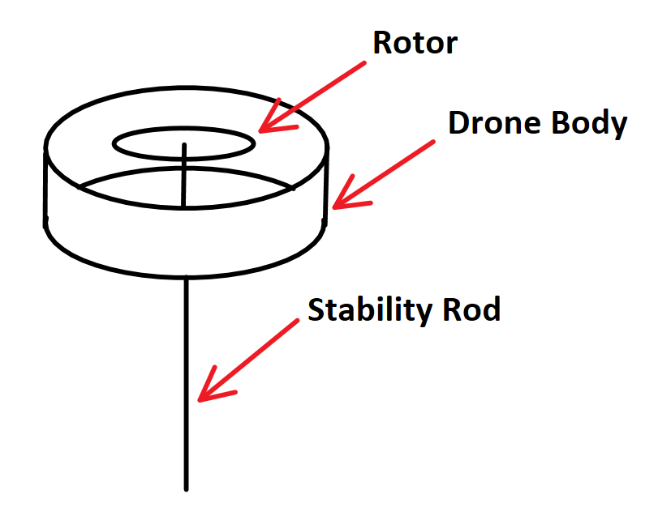
Model Difficulties
Vijay Kumar
Math becoming increasingly difficult
Redesign & coaxial rotor design
Counter-Torque spin of mass
Refocus on mass actuator
Notes:
Angle slide

Slide 26
Motor Comparison: Torque & Speed
Motor | Pros | Cons
Stepper | lower speed, Torque control, encoder | Weight, size, energy
Servo | High speed & torque, energy efficient, weight | Lower speed range
Permanent Magnet DC | Great Starting torque, good speed regulation | Limited Torque
Series DC | Large Starting Torque | No speed regulation
Shunt DC | Great speed regulation | Low Starting Torque
Compound | Good Starting Torque | Poor Speed Regulation
Notes:
Angel slide

Slide 27
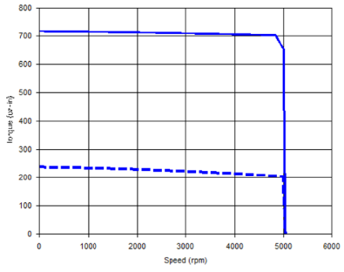
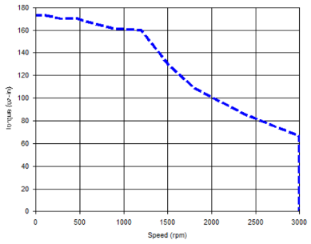
Motor Conclusion
Stepper w/ Enc. | Servo w/ Enc. | Permanent Magnet DC w/ Enc.
Stall Prevention Stall Detection Torque Control No tuning when commanding position Heat due to full current draw Lose torque as speed is increased | Increase current/torque to correct for errors in motor speed Require tuning when commanding position Flat Torque vs speed curve | Absolute encoder allows the determination of position. Can use PID regulator Can calculate speed from angular position
CrazyFlie Limitations
7mm brushed DC
Weight: 2.7g
Kv: 14000 rpm/V
Medium sized drone
Stepper or Servo
Notes:
Explain what Kv is, (velocity constant or back emf
Figures are torque vs speed relation for stepper vs servo
Played around with the stepper motor in the maker space, but someone stole it or something.

Slide 28
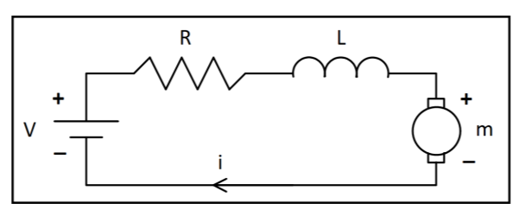
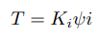
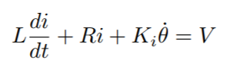
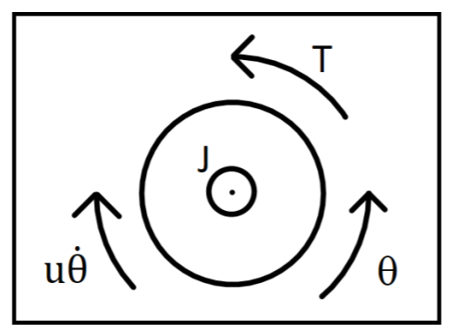
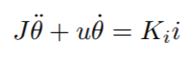
Motor Control: Physical Representation
Assumptions:
Voltage input
Rotational speed output
Rigid components
Constant E-Field
Friction Torque is proportional to angular velocity

Slide 29
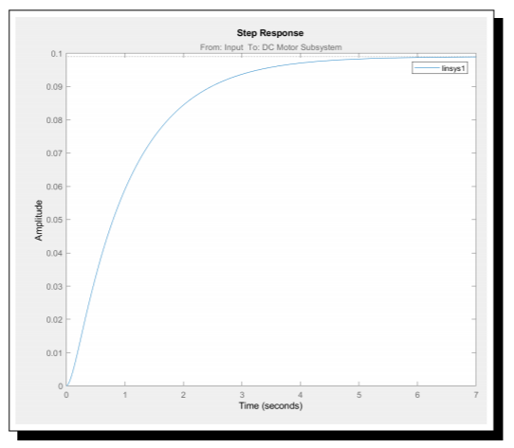
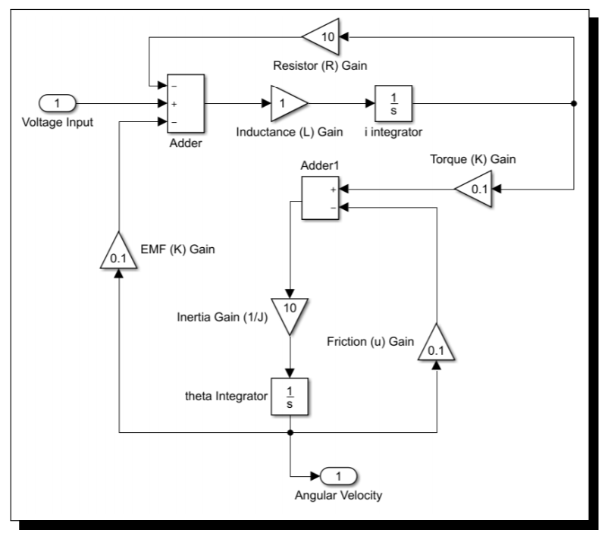
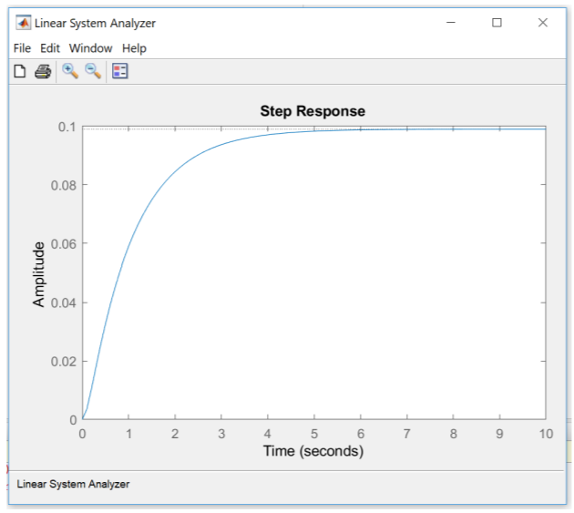
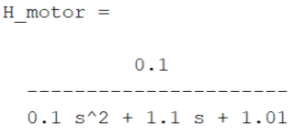
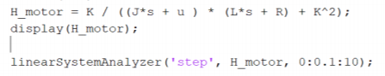
Motor Control: Speed
Notes:
Angel slide

Slide 30
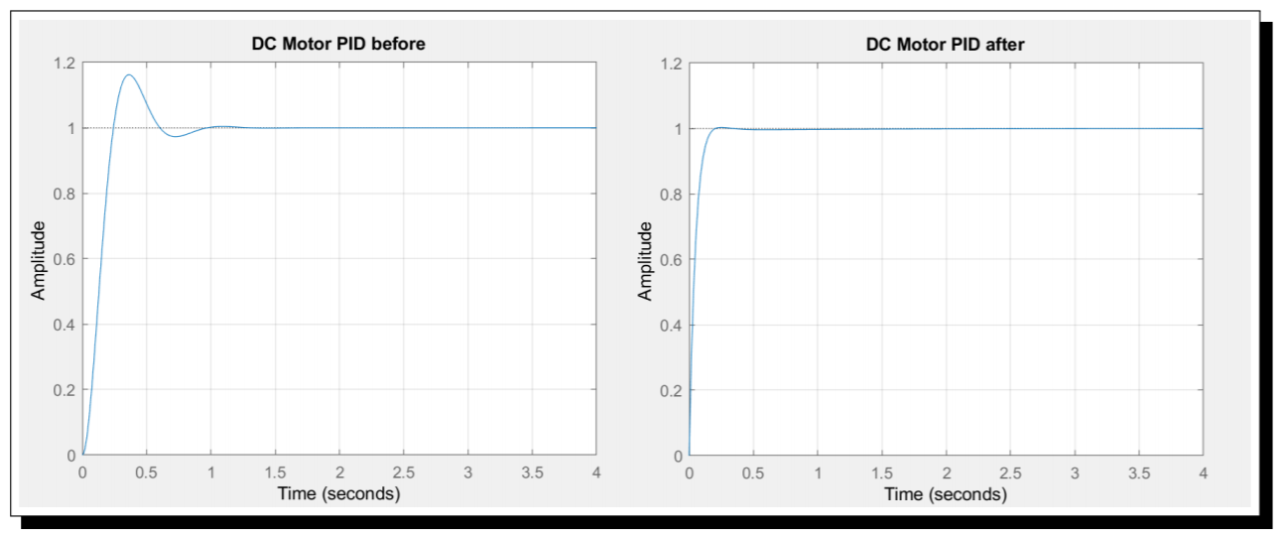
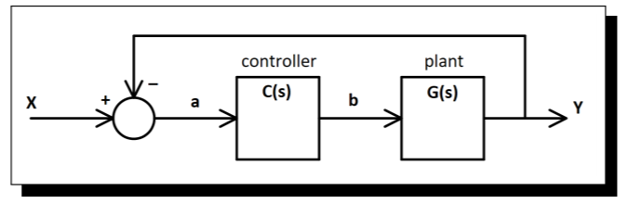
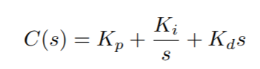


Motor Control: Speed

Slide 31



Motor Control: Position
Simulink Simscape
ssc_dcmotor
Similar assumptions
DC Values need to be measured in lab
Notes:
Angel slide

Slide 32
Challenges
Mathematical modeling
OCSM Dynamics can be tricky
Modeling various types of motors is time consuming
Getting Motors we can test
Cost of the motors we need

Slide 33




Actual Implementation
CF2.0 Software resources /coding:
Getting sensor measurements from CF2.0 IMU
Activate PS4 controller
Notes:
For the first couple weeks we worked on understanding the CF2 open source softwares:
Python library to upload code to perform different flight patterns
Virtualbox to do controlling on use different built in softwares to control and get data measurement from the drone
The software, firmware and utilities have functionality such as logging, real-time parameter setting and wireless firmware updates.
The complete development environment for most of the subsystems is available in a virtual machine

Slide 34





Actual Implementation
Rotating arm design:
Modifications added
Max Payload | 15 g
Motor weight | 2.7g
Spinning mass | <10g
Notes:
After understanding the drone specs, we started with designing our rotating arm
Challenges:
maximum weight 42g → payload 15g
Too little space to implement the driver 9cm^2 grid
Almost two weeks redeisgned and added some modifications → follow the pictures

Slide 35

Actual Implementation
3. Choose the DC motor to use :
Use the same motor as CF2’s motors:
Mainly due the payload limit
Current and voltage ratings matched with our battery constraints
Rated voltage 4.2V
Rated current 1000mA
Test results in lab:
Run at V=0.5v, I=0.4A
Stall current~ 3.5A
Handle up to 40g mass
Max Payload | 15 g
Motor weight | 2.7g
Spinning mass | <10g
Notes:
The process to pick the ideal motor for controller was also constrained by max payload of the drone and the driver’s power supply.
→ CF motor was ideal since they were light and were able to spin at a decent speed with less than a volt

Slide 36

Actual Implementation
4. Circuit Design :
Initially began with designing schematics for PCB:
Needed Components:
MCU
Motor Driver
Voltage Regulator
DC motor
Encoder
Programmer pins
RF/Bluetooth Module
Same MCU as CF
Voltage regulator is not needed
RF/Bluetooth module+programming (through micro usb is provided)
More robust connection to user controller
Notes:
Initially as planned in last quarter we wanted to have our own PCB:
Spent half a week to come up with schematics and design our circuit but then
We found out about unused IO pins on CF2 MCU
Component redundancy
Communication issue between CF2 and controller

Slide 37

Actual Implementation
4. Circuit Design :
So decided to use the I/O pins on CF2 MCU:
IO 1: for PWM pin
GND
VCC (3V)
A1 for Encoder
Notes:
This way our input signals would be mapped to only one MCU
there’s no need to take another step in transmitting signal to another MCU
Assuming programming MCU is

Slide 38



Actual Implementation
5. Motor Driver :
Bidirectional motor driver using H-bridge:
Unidirectional motor driver:
Notes:
Bi-directional :
Different sources of VCC were needed in order to get the circuit to work
Unidirectional:
Pull down resistor was not
Fried a motor so addeda 10 ohm resistor

Slide 39



Actual Implementation
5. Motor Driver :
Both designed were tested on CF2’s MCU, however uni directional design was picked to be soldered on perfboard for implementation on MCU mainly for simplicity:
Additional connections with different JST connector were used to build the circuit on perfboard
10 ohm Resistor added here
Demo Link : https://youtu.be/xGmaOrivyys
Notes:
Implement the uni-directional motor on the drone:
Added our own jst connectors in place of battery and

Slide 40
Actual Implementation Challenges
Crazyflie interface
Hard to code
PWM
Quadcopter Dynamics is hard
Motor driver
Planning
Notes:
Assumptions that made us underestimate the project :
We assumed we could program the CF2 MCU in order to generate a PWM signal
Now coding a simple PWM took us 80 lines of code in very low level c language and takes → a minute every time we wanted to upload the code
Divide problems into the smallest and easiest sub problems possible:
Controller circuit → bi/uni directional
PS4 controller for a week
Setting up the encoder
Basic ideas and lessons we had learned came back to us:
Motor driver circuit : common ground, pull down resistor
Newton’s second law
Fixture design : Use of Foam
Last but not least: Quadcopter dynamics
Didn’t get a chance to work on it
Future work → consider the possibility of serial communication and come up with ways around controller dynamics in order to switch the coding to an easier high level platform

Slide 41
Conclusion
Researchers can look into our work if they have similar ideas as ours, we explored different possibilities on this hard control problem
Plan better and execute the plans wiser,
Ex: started hacking the quadcopter in the first 5 weeks,
Instead of waiting for the math model to come out until 5th week
Underactuated Robotics is very math based, since it makes use of system’s dynamics

Slide 42
Expectation of live demo
Show our work in each domain
Paper that shows our Math model -- Wilson
Computer that we can play with the simulation -- Lin
Motor research and possibly a simulation -- Angel
Actual implementation of the quadcopter -- Amir

Slide 43
References
https://www.bitcraze.io/2014/08/crazyflie-2-0-expansion-port/
https://store.bitcraze.io/collections/spare-parts/products/7-mm-dc-motor \break
https://www.micromo.com/technical-library/dc-motor-tutorials/motor-calculations
https://en.wikipedia.org/wiki/Armature_Controlled_DC_Motor
http://tutorial.math.lamar.edu/pdf/Laplace_Table.pdf
https://en.wikipedia.org/wiki/State-space_representation
http://ctms.engin.umich.edu/CTMS/index.php?aux=Home
http://www.ecircuitcenter.com/Circuits/dc_motor_model/DCmotor_model.htm

